Slide 1
Multi-Threading in Java

Slide 2
What is Multitasking ?
Multitasking is the ability to perform more than one activity concurrently on a computer. We can further break multitasking into process based and thread based .
We use multitasking to utilize the CPU. Multitasking can be achieved in two ways:
1)Process-based Multitasking (Multiprocessing)
2)Thread-based Multitasking (Multithreading)

Slide 3
What is Process ?
A process or running process refers to a set of instructions currently being processed by the computer processor. A process is heavyweight.
For example, in Windows you can see each of the processes running by opening the Processes tab in Task Manager.

Slide 4
What is Thread ?
A thread is a lightweight subprocess, the smallest unit of processing.
A program is capable of having multiple threads open at once and terminates or suspends them after the task is completed or the program is closed.

Slide 5
Thread-based Multitasking (Multithreading)
Thread-based multitasking allows different parts of the same process ( program ) to run concurrently .
A good example is printing and formatting text in a word processor at the same time.

Slide 6
Thread Based Multitasking Programming
In thread based multitasking two or more threads can be run concurrently.
In thread based multitasking a thread is the smallest unit.
Threads share same address space.
Thread to Thread communication is not expensive.
It is comparatively light weight.
It has faster data rate multi-tasking.

Slide 7
Process-based Multitasking (Multiprocessing)
Process-based multitasking allows processes
( or programs ) to run concurrently on a computer.
For example , running different applications at the same time like downloading a file and printing a file .

Slide 8
Process Based Multitasking Programming
In process based multitasking two or more processes and programs can be run concurrently.
Each process allocates a separate memory area.
Process to Process communication is expensive.
It is comparatively heavy weight.
It has slower data rate multi-tasking.

Slide 9
Relation between the main() method and main thread in Java
For each program, a Main thread is created by JVM(Java Virtual Machine). The “Main” thread first verifies the existence of the main() method, and then it initializes the class.
The main thread is the thread that starts your program, or simply which runs your public static void main(String... args) method.

Slide 10
Life cycle of a Thread
The life cycle of the thread in java is controlled by JVM. The java thread states are as follows:
New
Runnable
Running
Non-Runnable (Blocked)
Terminated

Slide 11
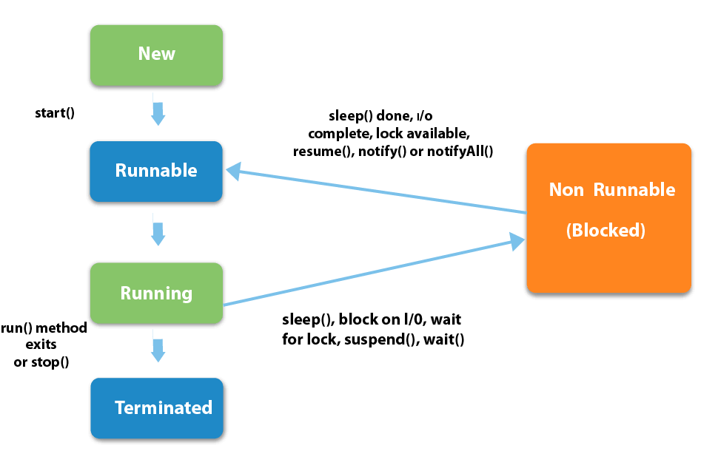

Slide 12
1) New : The thread is in new state if you create an instance of Thread class but before the invocation of start() method.
2) Runnable : The thread is in runnable state after invocation of start() method, but the thread scheduler has not selected it to be the running thread.
3) Running : The thread is in running state if the thread scheduler has selected it.
4) Non-Runnable (Blocked) : This is the state when the thread is still alive, but is currently not eligible to run.
5) Terminated : A thread is in terminated or dead state when its run() method exits.

Slide 13
Creating a thread in Java
There are two ways to create a thread in Java: 1) By extending Thread class. 2) By implementing Runnable interface.
Before we begin with the programs(code) of creating threads, let’s have a look at these methods of Thread class. We have used few of these methods in the example below.
getName(): It is used for Obtaining a thread’s name
getPriority(): Obtain a thread’s priority
isAlive(): Determine if a thread is still running
join(): Wait for a thread to terminate
run(): Entry point for the thread
sleep(): suspend a thread for a period of time
start(): start a thread by calling its run() method

